Slide 1
History of Trading
WALID KHOYI
BADR GRARI

Slide 2
What is trading ?
Basically trade means exchange of goods, services, or both.
Trade originated with human communication in prehistoric times. Trading was the main facility of prehistoric people[citation needed], who exchanged goods and services from each other in a gift economy before the innovation of modern-day currency. Peter Watson dates the history of long-distance commerce from circa 150.000 years ago.

Slide 3

Hey you
What ?
Give me X I will give you Y
0
The start
point
OK

Slide 4

Bartering
1
In trade, bartering is the oldest system of exchange in which participants in a transaction directly exchange goods or services for other goods or services without using a medium of exchange . Such as ...

Slide 5
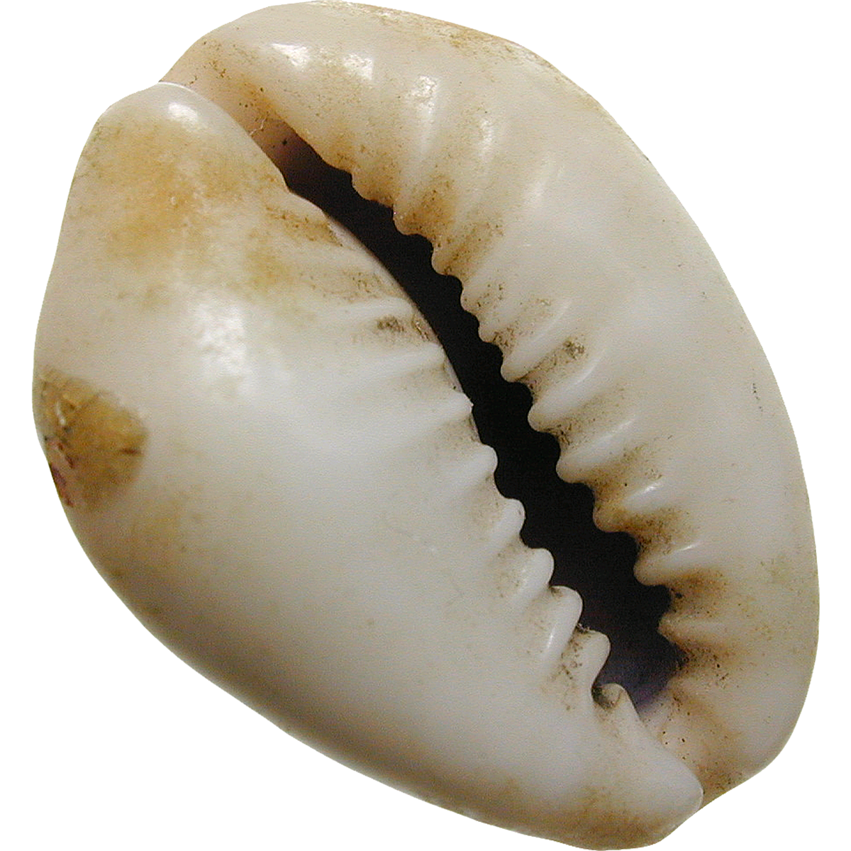
Medium of exchange
Medium of exchange is a term referring to any item that is widely acceptable in exchange for goods and services. The underlying assumption in designating a "medium of exchange" is that one cannot acquire a good or service from another, without having to provide the other with something material in exchange.
People
Used such
As meduim
Of exchange
CATTLE
9000 BC
Then
Cowrie shell
1200 BC
T1

Slide 6
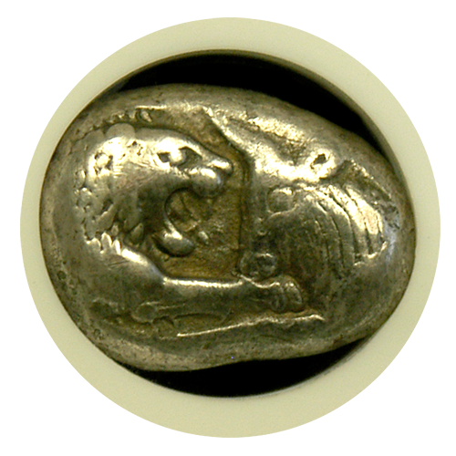
Coining
The earliest coins are mostly associated with Iron Age Anatolia of the late 7th century BC, and especially with the kingdom of Lydia. Early electrum coins (usually about 40–55% gold) were not standardized in weight, and in their earliest stage may have been ritual objects, such as badges or medals, issued by priests. The unpredictability of the composition of naturally occurring electrum implied that it had a variable value, which greatly hampered its development. Most of the early Lydian coins include no writing ("myth" or "inscription"), only an image of a symbolic animal.
4

Slide 7
The are thefts in this road
I have the power to save your coins
Take my coins to Rome. I will
Trad there.
OK. Take this paper refers to 100
Coin . Then meet me at Rome.

Slide 8
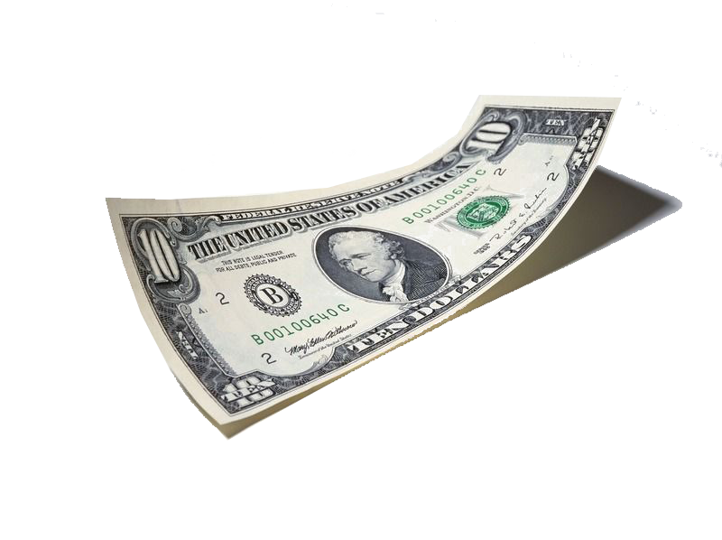
Banknote
The first banknote-type instrument was used in China in the 7th century, during the Tang dynasty (618–907). Merchants would issue what are today called promissory notes in the form of receipts of deposit to wholesalers to avoid using the heavy bulk of copper coinage in large commercial transactions.
Dollar is the
International
Currency in
Nowadays
Dollar is
Realated to
Gold and
Oil
5

Slide 9
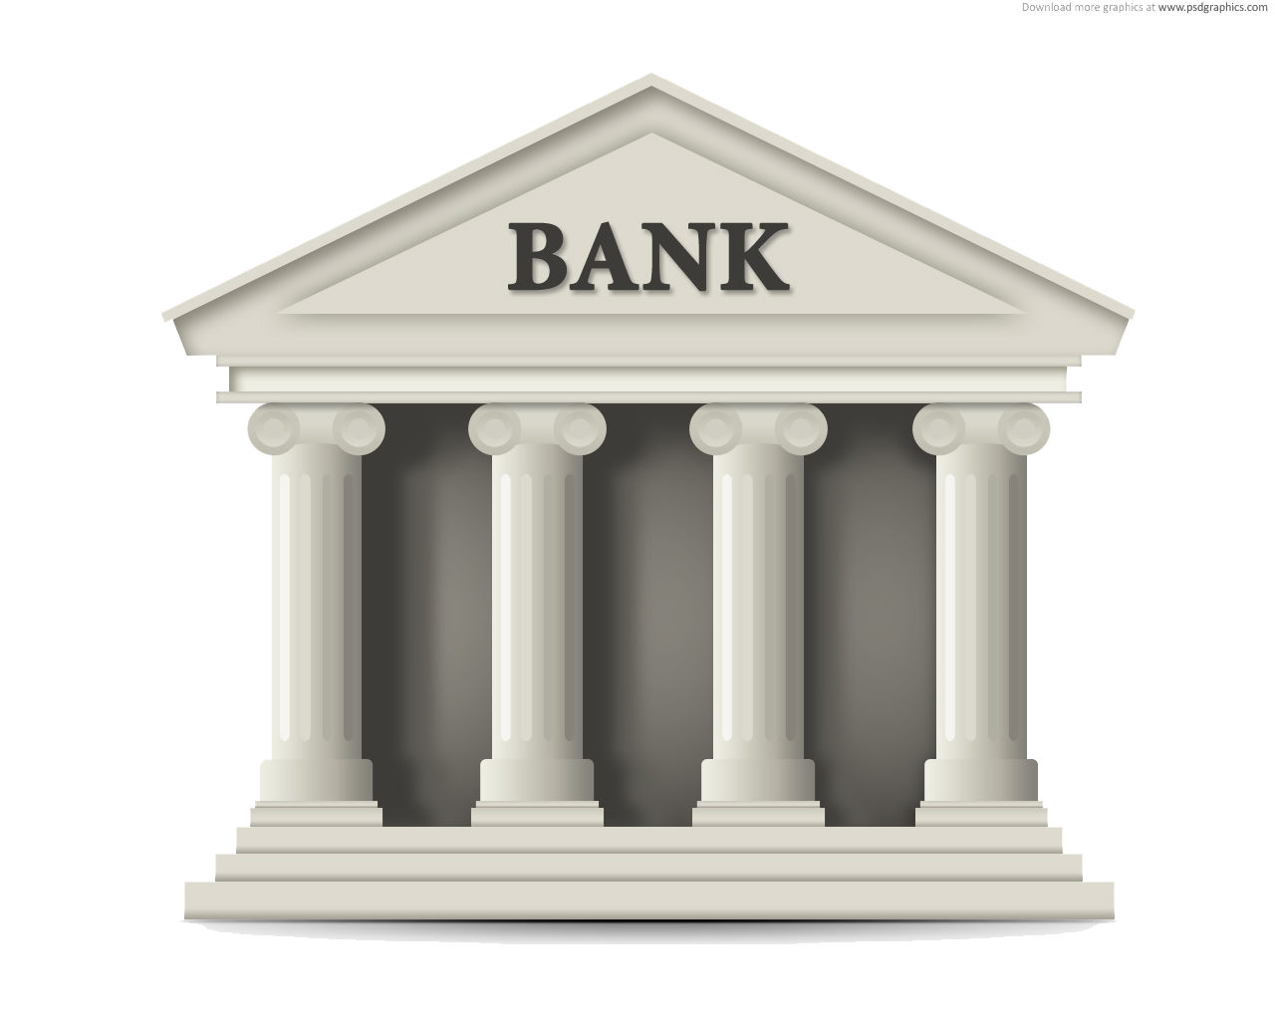
Bank history
Bank is an idea of saving coins, goods.
But bank are developed by a jew family named Rostchild.
Bank are who create the paper money to save the coin because coins was made by precious metal such as gold.
When human
Being
first began to
produce written
records of their
activities they
did so
not to write
History
, poetry
or philosophy,
but to do
business
6

Slide 10
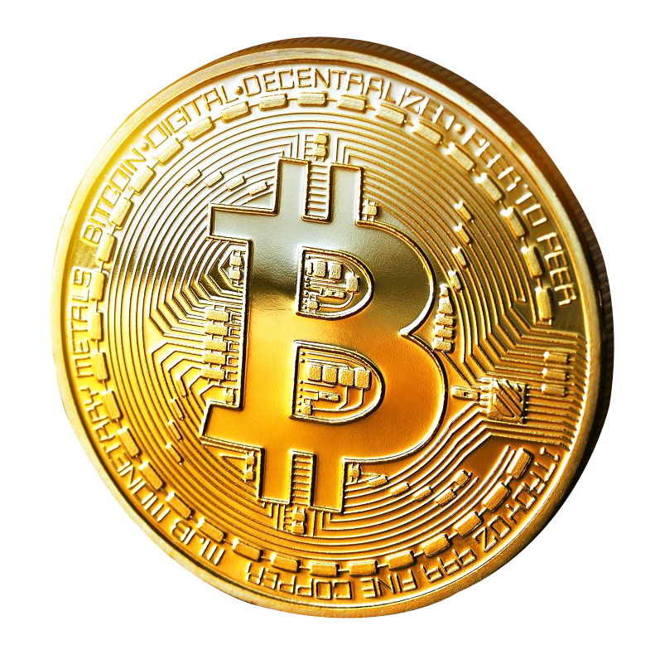
Digital currency
Digital currency is a form of currency that is available only in digital or electronic form, and not in physical form. It is also called digital money, electronic money, electronic currency, or cyber cash.
7

Slide 11
Now
The end

